Slide 1

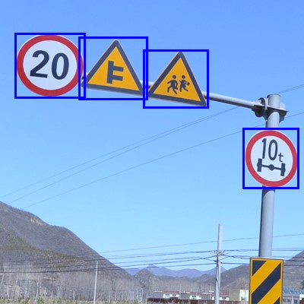
Mid Term Project – Team 14
Traffic Sign Detection
DSCI-6007-03
Tagliatela College of Engineering – Data Science
Spring 2024

Slide 2




Team Members
Lokesh Dammalapati Product Manager
Shashank Madipelly
Machine Learning Engineer
Keerthi Kappera Software Engineer / Developer
Meghana Bodduluri Quality Assurance (QA) Engineer

Slide 3
The Problem
Illumination and Weather Variability
Occlusions and Partial Visibility
Dynamic Environments and Rapid Changes
Problem #1 Traffic signs may be exposed to varying lighting conditions and weather elements (e.g., rain, snow, fog), leading to drastic changes in image quality.
Problem #2 Traffic signs may be partially covered, obstructed, or hidden behind other objects such as trees, vehicles, or infrastructure.
Problem #3 Traffic scenarios are dynamic, with frequent changes in road conditions, traffic flow, and the appearance of temporary signs (e.g., construction signs)
01
02
03

Slide 4
The Solution
Solution #1 Integration of adaptive illumination techniques, use of infrared sensors, and advanced image preprocessing algorithms can help mitigate these challenges.
Solution #2 Advanced object detection models, multi-sensor fusion (combining data from cameras, LiDAR, radar), and incorporating contextual information can enhance the system's ability to handle occlusions.
Solution #3 Real-time updating of the model, continuous learning techniques, and the integration of data from vehicle-to-everything (V2X) communication systems can enhance the system's adaptability to dynamic environments
01
02
03

Slide 5
Market Size
2032
68.5M
44.7M
2023
42.1M
2022

Slide 6
Business model / Plan
Business Understanding
Monitoring and Maintenance
Data Collection and Exploration
CRISP-DM
Deployment
Model Development
Evaluation and Validation

Slide 7
Technology/expertise
Computer Vision and Deep Learning Convolutional Neural Networks (CNNs) and deep learning architectures are commonly used for image recognition tasks, including TSR.
Implementing Traffic Sign Recognition (TSR) involves leveraging specific technologies and expertise. Here are three key elements.
Image Processing and Computer Graphics Advanced image processing techniques, including edge detection, color space transformation, and contrast enhancement, contribute to robust feature extraction from traffic sign images.
Embedded Systems and Real-Time Processing Implementation of TSR in real-world applications often requires integration with embedded systems, onboard cameras, and real-time processing capabilities.

Slide 8
Why We are Better?
Success of the TSR project, emphasizing accuracy, reliability, and adaptability, leading to enhanced road safety and effective traffic sign recognition in real-world conditions.
High Accuracy and Reliability of the TSR system through advanced deep learning algorithms.
Adaptability to Varied Conditions, ensuring robust performance under diverse scenarios.
Precision Assurance Advanced deep learning algorithms for high accuracy and reliability.
Adaptive Recognition Dynamics
Robust performance in varied conditions for real-world effectiveness.
Sentinel+ Traffic Sign Mastery Where Precision Meets Adaptability for Enhanced Road Safety.

Slide 9
Roadmap, metrics milestones
$2.25 Million Raising
Project Initiation and Planning #1
Establish project team and roles.
Define TSR system requirements.
Conduct feasibility study and project planning.
Development and Model Training #2
Complete data collection and annotation.
Develop and fine-tune deep learning model.
Conduct initial testing and optimization.
Implementation and Testing#3
Implement real-time processing capabilities.
Conduct extensive testing under diverse conditions.
Finalize documentation and user interfaces.

Slide 10


